Slide 1
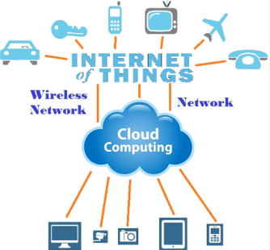
IOT AND CLOUD COMPUTING
By,
Ass. Prof. Kunal D Gaikwad
Pursuing PHD (IOT and Machine Learning)
M.E(Computer Networks)
B.E(Computer Science & Engineering)
Diploma(Computer Engineering)
Ass. Prof. Kunal D Gaikwad
CSE Department, CMRIT

Slide 2
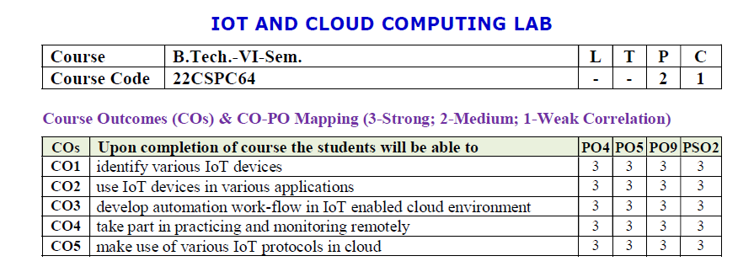
Ass. Prof. Kunal D Gaikwad
CSE Department, CMRIT

Slide 3
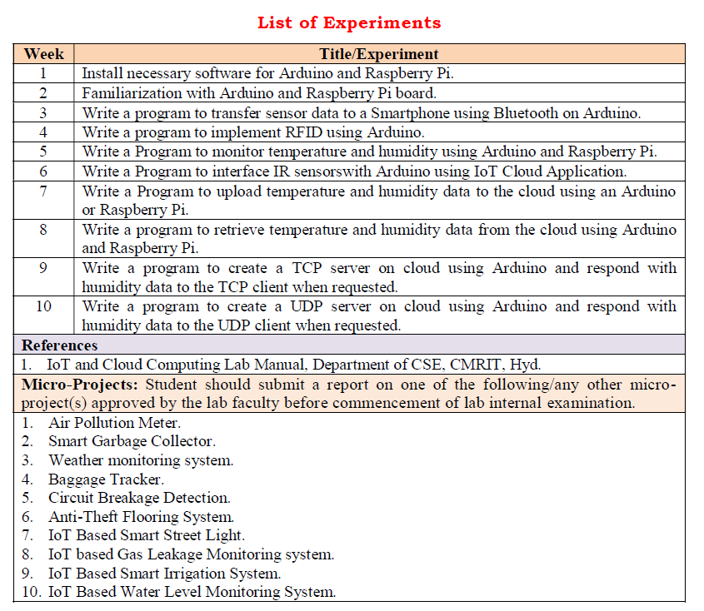
Ass. Prof. Kunal D Gaikwad
CSE Department, CMRIT

Slide 4
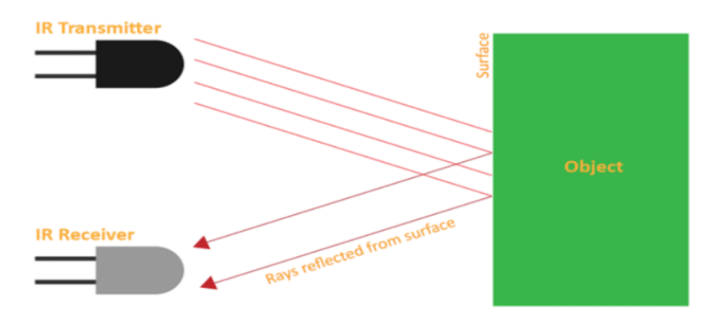
An IR (Infrared) sensor in IoT (Internet of Things) is a device that uses infrared light to detect objects, measure distances, or sense heat emitted by an object.
It plays a crucial role in IoT applications like:
Motion detection: Used in smart home security systems to detect movement.
Proximity sensing: Detects objects in close range, such as in automatic doors.
Environmental monitoring: Measures heat levels for applications like smart thermostats or industrial safety.
Remote control: Enables communication between devices using IR signals.
It is energy-efficient, cost-effective, and widely used in IoT devices for automation and monitoring tasks.
IR Sensor
Ass. Prof. Kunal D Gaikwad
CSE Department, CMRIT

Slide 5
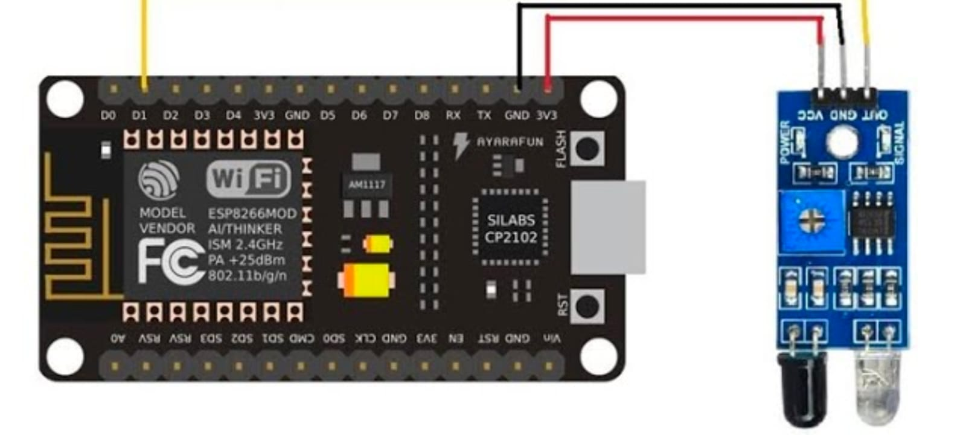
IR Sensor
Ass. Prof. Kunal D Gaikwad
CSE Department, CMRIT

Slide 6
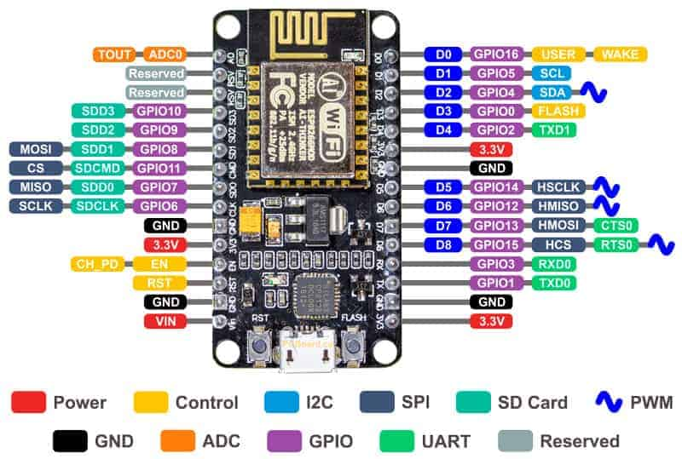
Ass. Prof. Kunal D Gaikwad
CSE Department, CMRIT

Slide 7


Slide 8
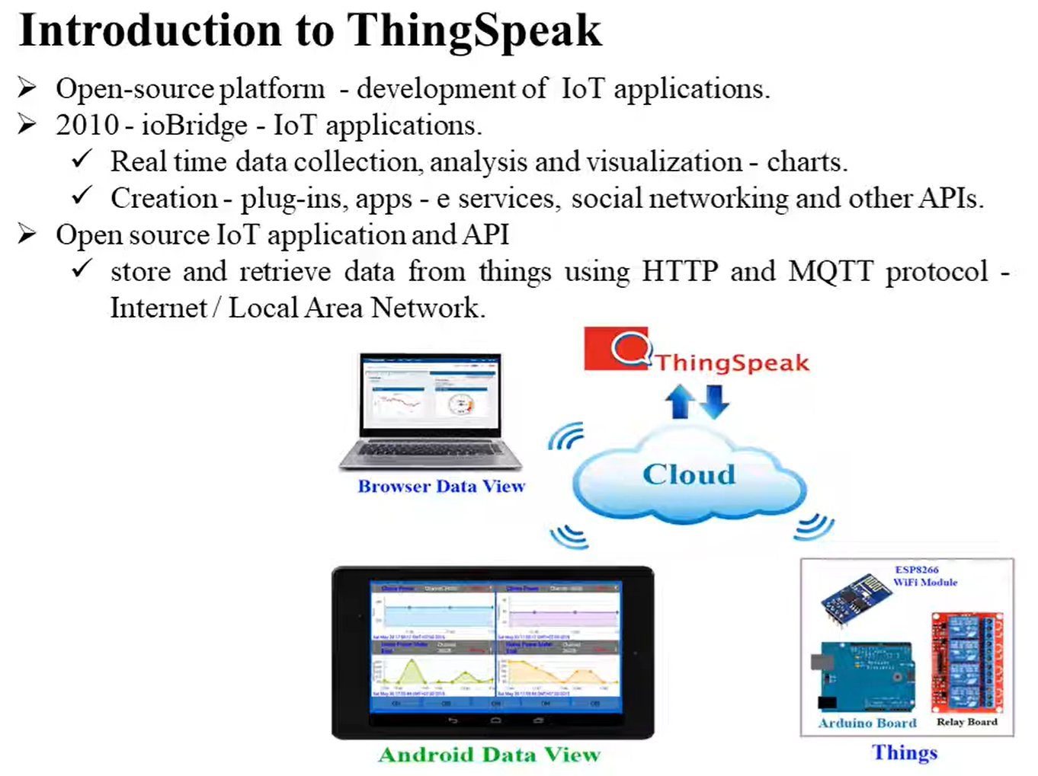

Slide 9
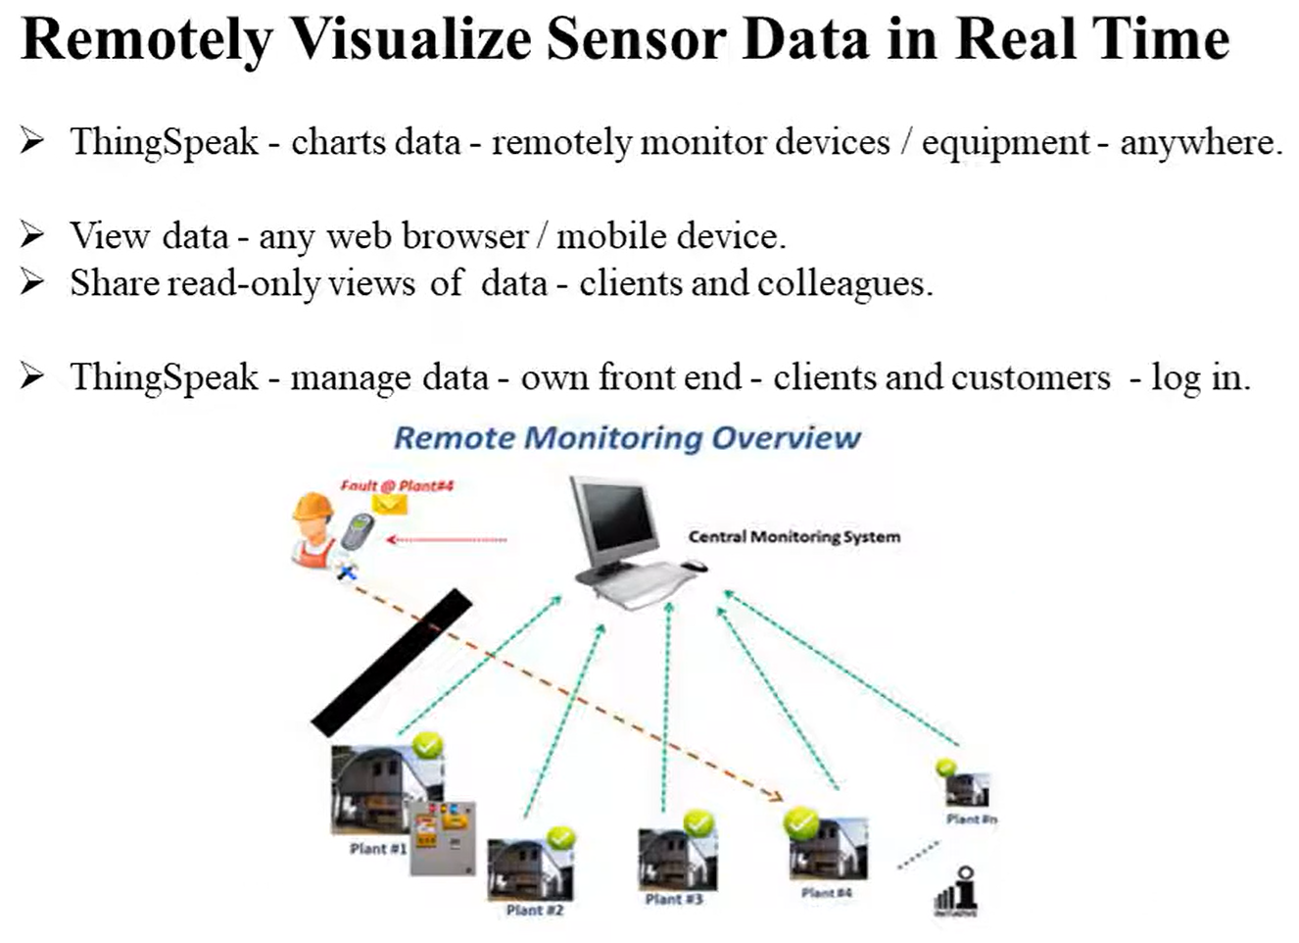

Slide 10
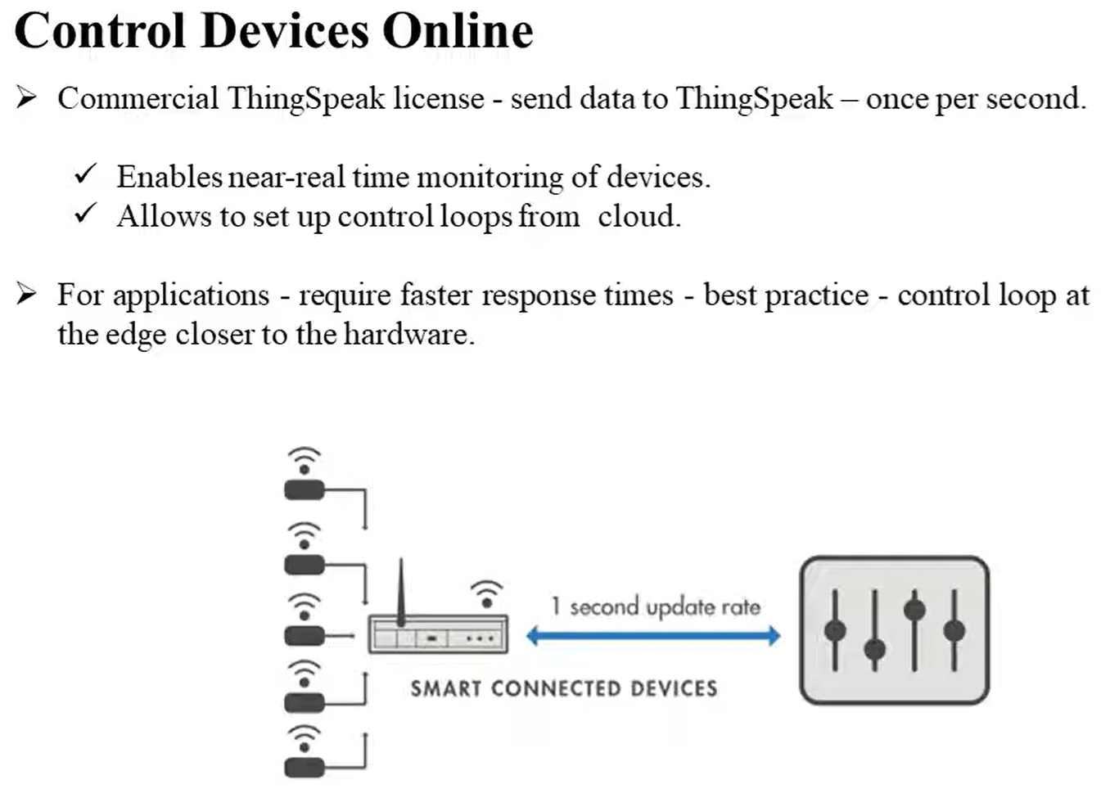

Slide 11
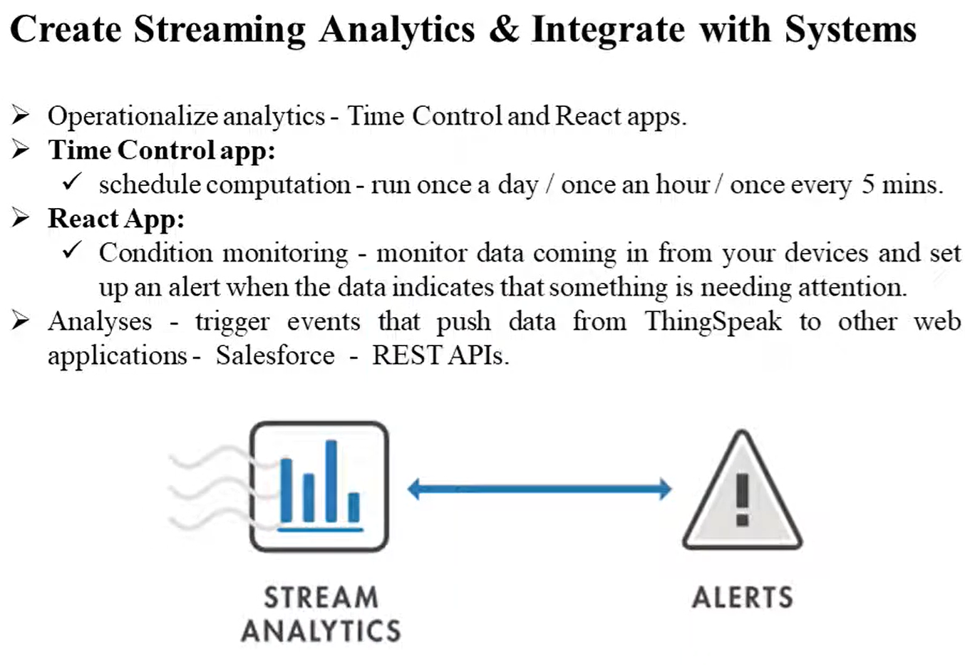

Slide 12
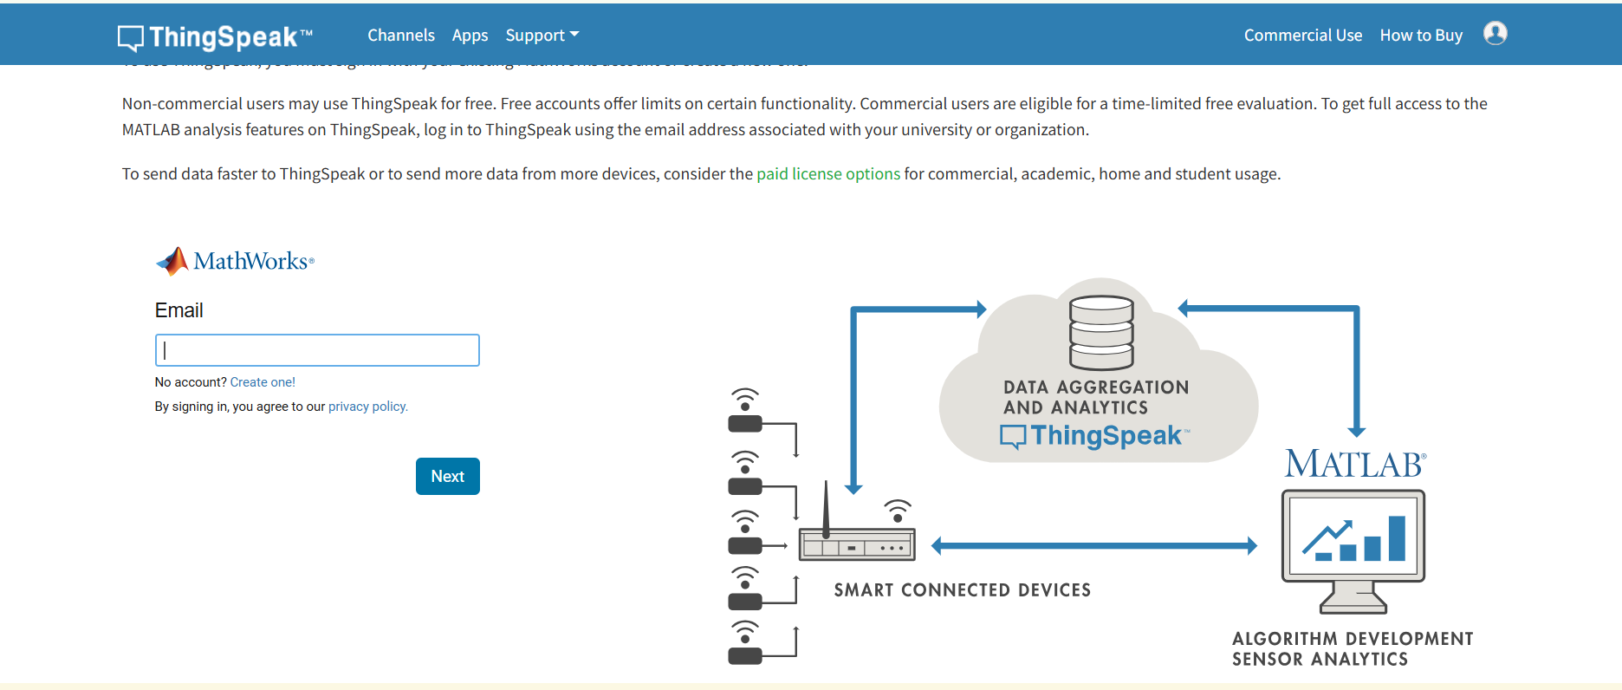
Ass. Prof. Kunal D Gaikwad
CSE Department, CMRIT

Slide 13
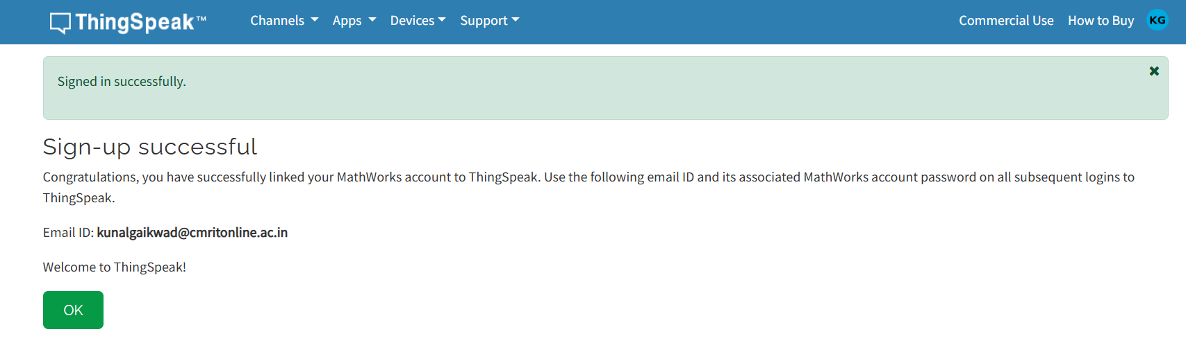
Ass. Prof. Kunal D Gaikwad
CSE Department, CMRIT

Slide 14
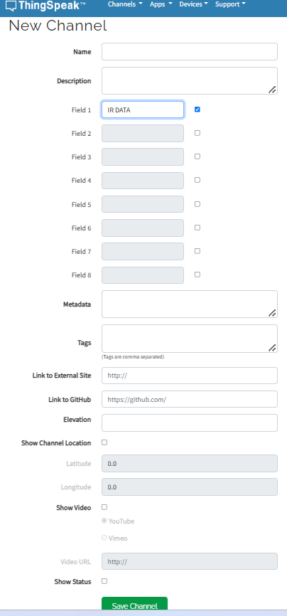
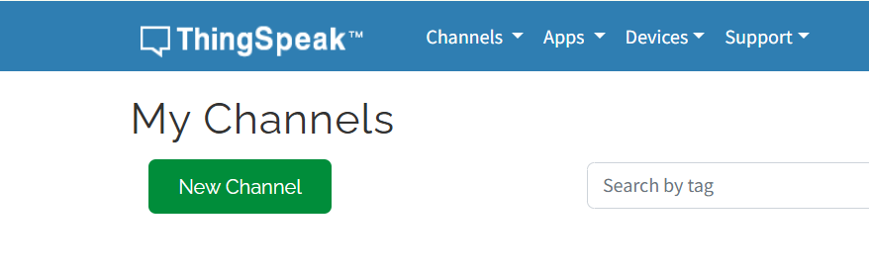
Ass. Prof. Kunal D Gaikwad
CSE Department, CMRIT

Slide 15
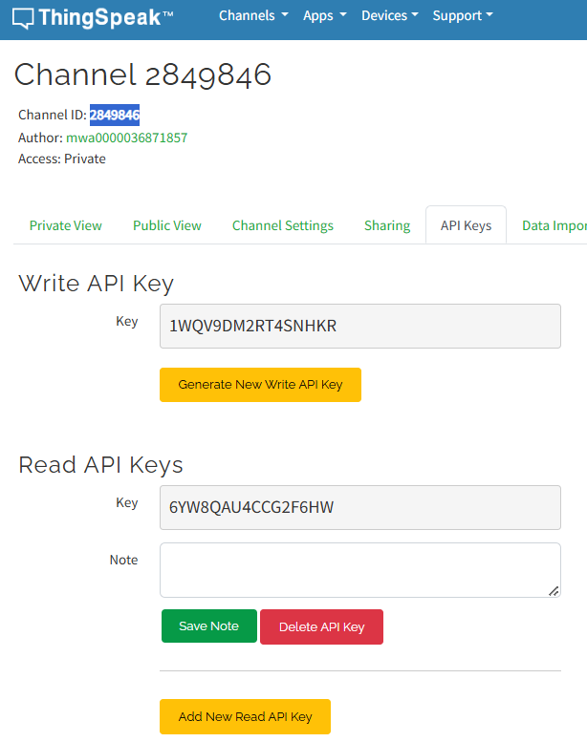
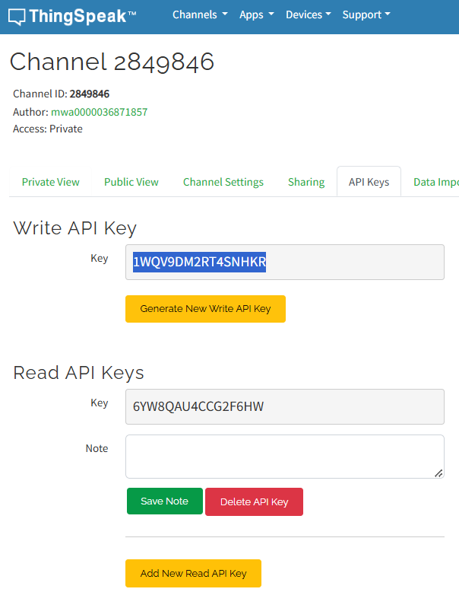
Ass. Prof. Kunal D Gaikwad
CSE Department, CMRIT

Slide 16
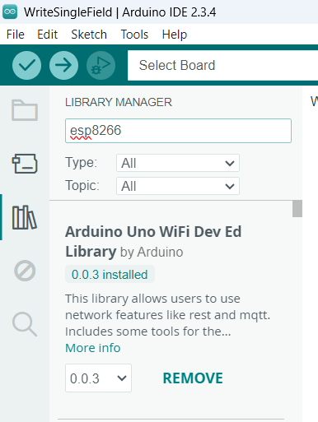
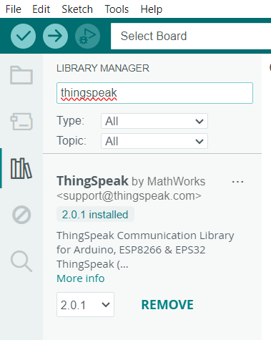
Ass. Prof. Kunal D Gaikwad
CSE Department, CMRIT

Slide 17
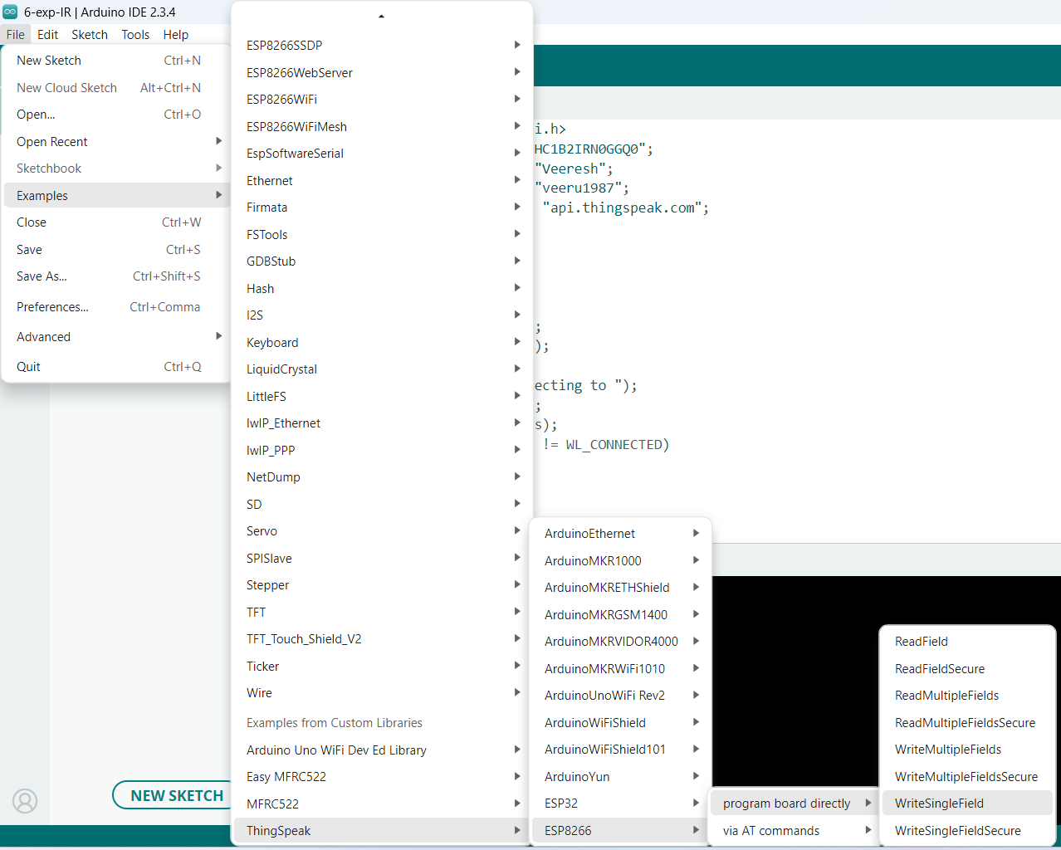
Ass. Prof. Kunal D Gaikwad
CSE Department, CMRIT

Slide 18
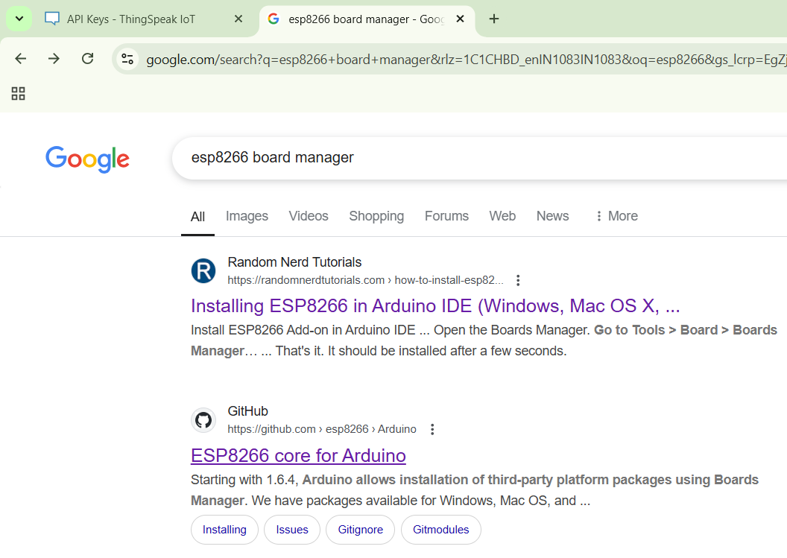
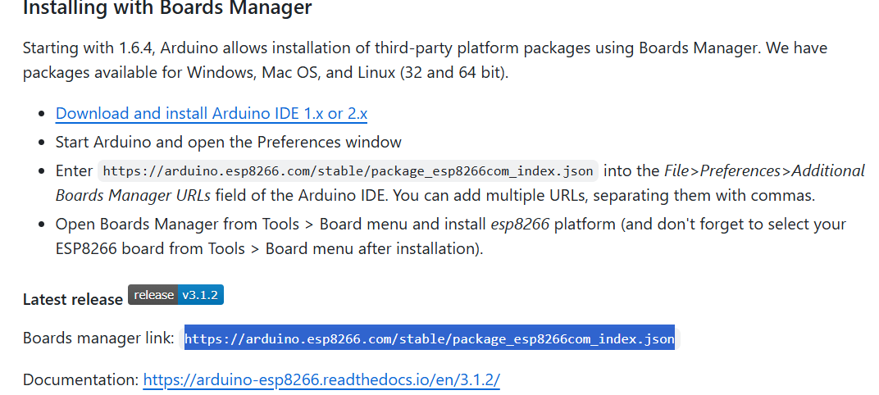
Ass. Prof. Kunal D Gaikwad
CSE Department, CMRIT

Slide 19

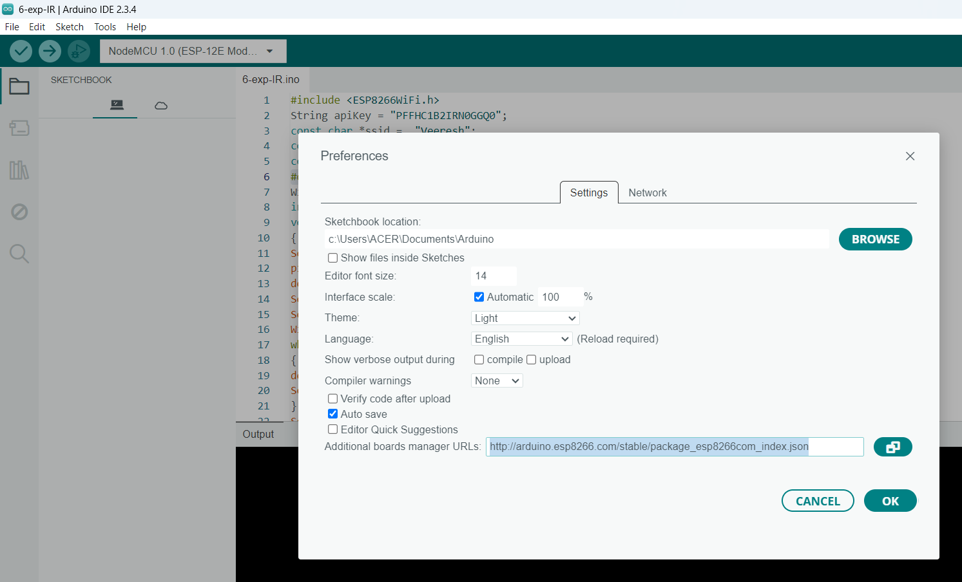
Ass. Prof. Kunal D Gaikwad
CSE Department, CMRIT

Slide 20
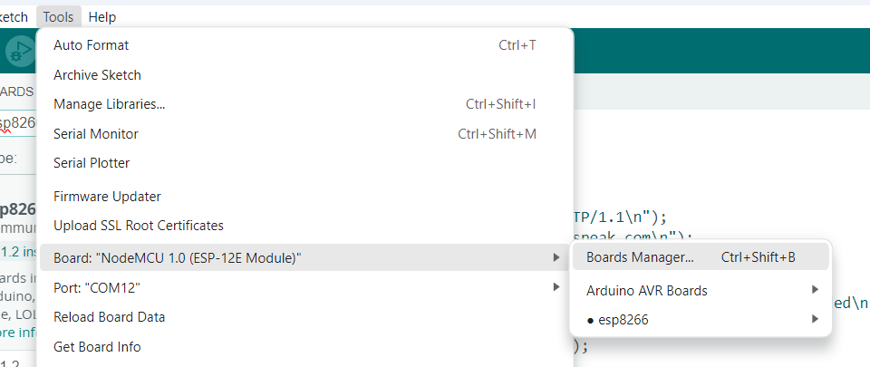
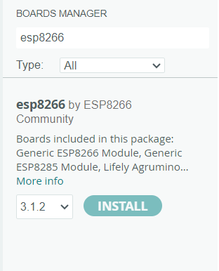
Ass. Prof. Kunal D Gaikwad
CSE Department, CMRIT

Slide 21
Ass. Prof. Kunal D Gaikwad
CSE Department, CMRIT

Slide 22
#include <ESP8266WiFi.h>
String apiKey = "PFFHC1B2IRN0GGQ0";// Your WRITE API KEY
const char *ssid = “kunal"; // Your mobile Hotspot Name
const char *pass = “12345678"; // Your Mobile Hotspot Password
const char* server = "api.thingspeak.com";
#define IRpin D4
WiFiClient client;
int value;
void setup()
{
Serial.begin(115200);
pinMode(IRpin, INPUT);
delay(1000);
Serial.println("Connecting to ");
Serial.println(ssid);
WiFi.begin(ssid, pass);
while (WiFi.status() != WL_CONNECTED)
{
delay(2000);
Serial.print(".");
}
Serial.println(" ");
Serial.println("WiFi connected");
}
void loop(){
value = digitalRead(IRpin);
Serial.println(value);
if(value==0)
{
Serial.print("object detected");
}
else
{
Serial.print("no object detected");
}
if (client.connect(server,80))
{
String postStr = apiKey;
postStr +="&field1=";
postStr += String(value);
postStr += "\r\n\r\n";
client.print("POST /update HTTP/1.1\n");
client.print("Host: api.thingspeak.com\n");
client.print("Connection: close\n");
client.print("X-THINGSPEAKAPIKEY: "+apiKey+"\n");
client.print("Content-Type: application/x-www-form-urlencoded\n");
client.print("Content-Length: ");
client.print(postStr.length());
client.print("\n\n");
client.print(postStr);
client.stop();
Serial.println("Waiting...");
delay(1000);
}
}

Slide 23
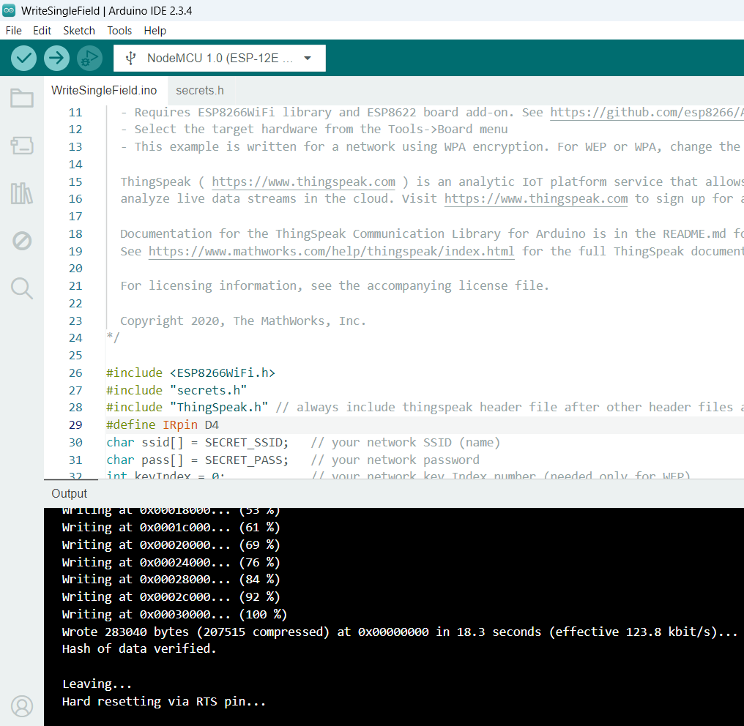
Ass. Prof. Kunal D Gaikwad
CSE Department, CMRIT

Slide 24
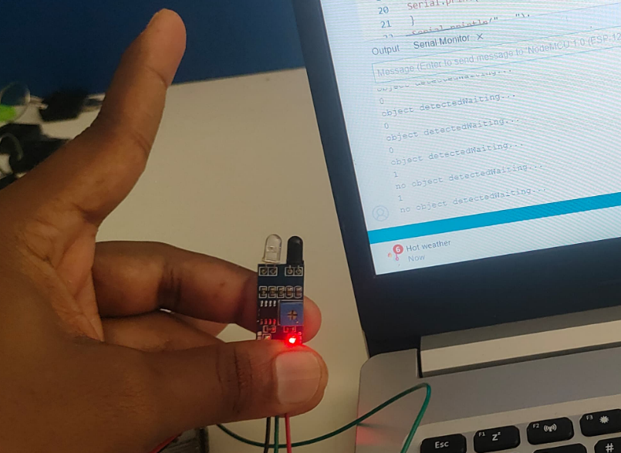
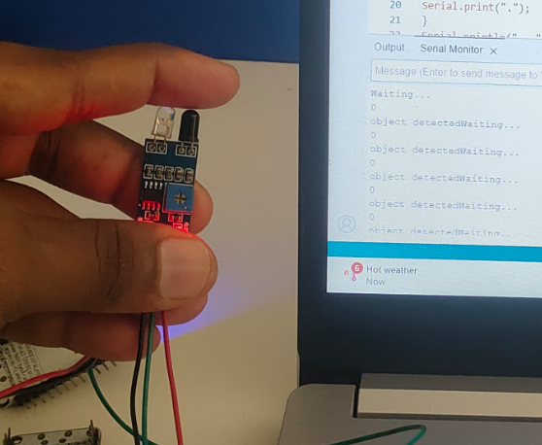

Slide 25
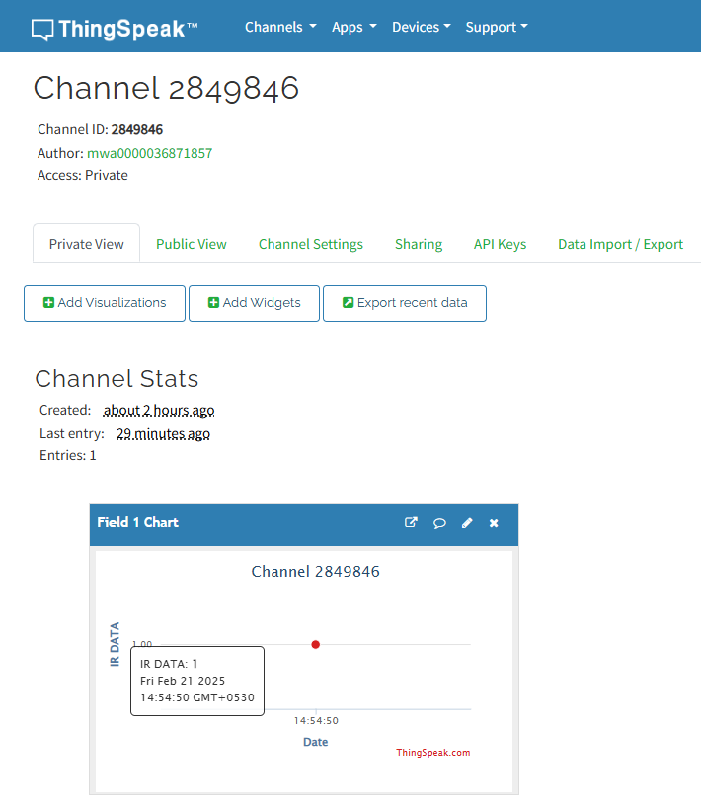
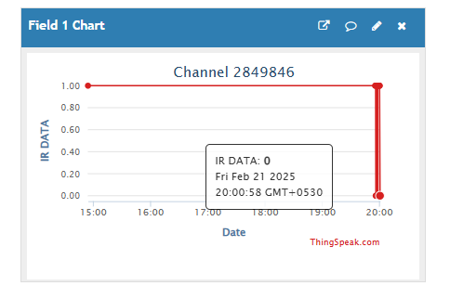
Ass. Prof. Kunal D Gaikwad
CSE Department, CMRIT

Slide 26
Ass. Prof. Kunal D Gaikwad
CSE Department, CMRIT

